Slide 1

Simulation: Continuous Time Dynamical System
MTH 564 – Mathematical Modeling

Slide 2

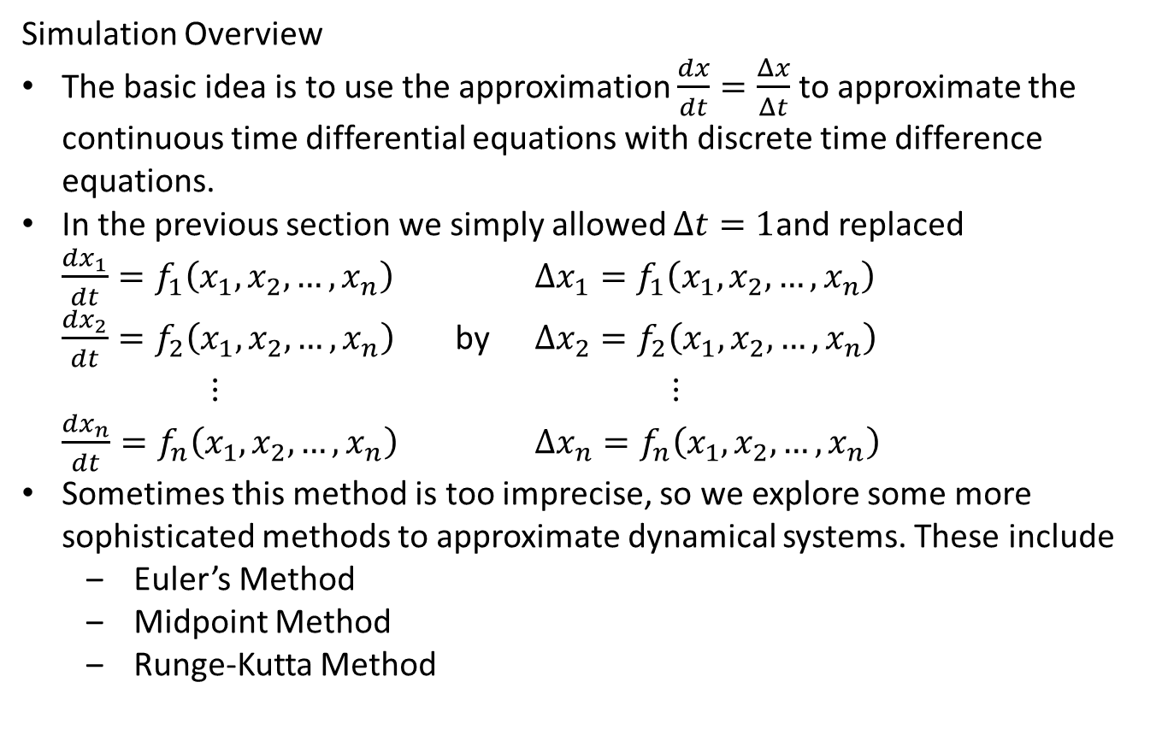
Simulation: Continuous Time Dynamical System
Simulation Overview
The basic idea is to use the approximation $\frac{dx}{dt}=\frac{Δx}{Δt}$ to approximate the continuous time differential equations with discrete time difference equations.
In the previous section we simply allowed $Δt=1$and replaced $\frac{dx_{1}}{dt}=f_{1}\left(x_{1},x_{2}, …, x_{n}\right)$ $Δx_{1}=f_{1}\left(x_{1},x_{2}, …, x_{n}\right)$ $\frac{dx_{2}}{dt}=f_{2}\left(x_{1},x_{2}, …, x_{n}\right)$ by $Δx_{2}=f_{2}\left(x_{1},x_{2}, …, x_{n}\right)$ $⋮$ $⋮$ $\frac{dx_{n}}{dt}=f_{n}\left(x_{1},x_{2}, …, x_{n}\right)$ $Δx_{n}=f_{n}\left(x_{1},x_{2}, …, x_{n}\right)$
Sometimes this method is too imprecise, so we explore some more sophisticated methods to approximate dynamical systems. These include
Euler’s Method
Midpoint Method
Runge-Kutta Method

Slide 3
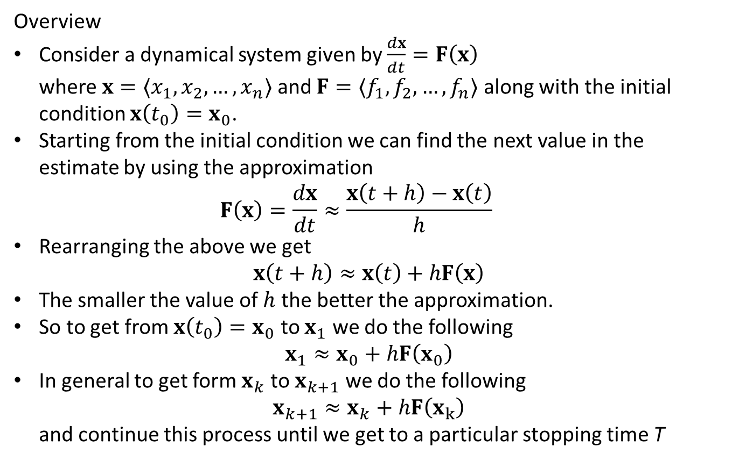
Euler’s Method
Overview
Consider a dynamical system given by $\frac{dx}{dt}=F\left(x\right)$ where ${x=〈x}_{1},x_{2}, …, x_{n}〉$ and ${F=〈f}_{1},f_{2}, …, f_{n}〉$ along with the initial condition $x\left(t_{0}\right)=x_{0}$.
Starting from the initial condition we can find the next value in the estimate by using the approximation $F\left(x\right)=\frac{dx}{dt}≈\frac{x\left(t+h\right)−x\left(t\right)}{h}$
Rearranging the above we get $x\left(t+h\right)≈x\left(t\right)+hF\left(x\right)$
The smaller the value of $h$ the better the approximation.
So to get from $x\left(t_{0}\right)=x_{0}$ to $x_{1}$ we do the following $x_{1}≈x_{0}+hF\left(x_{0}\right)$
In general to get form $x_{k}$ to $x_{k+1}$ we do the following $x_{k+1}≈x_{k}+hF\left(x_{k}\right)$ and continue this process until we get to a particular stopping time T

Slide 4
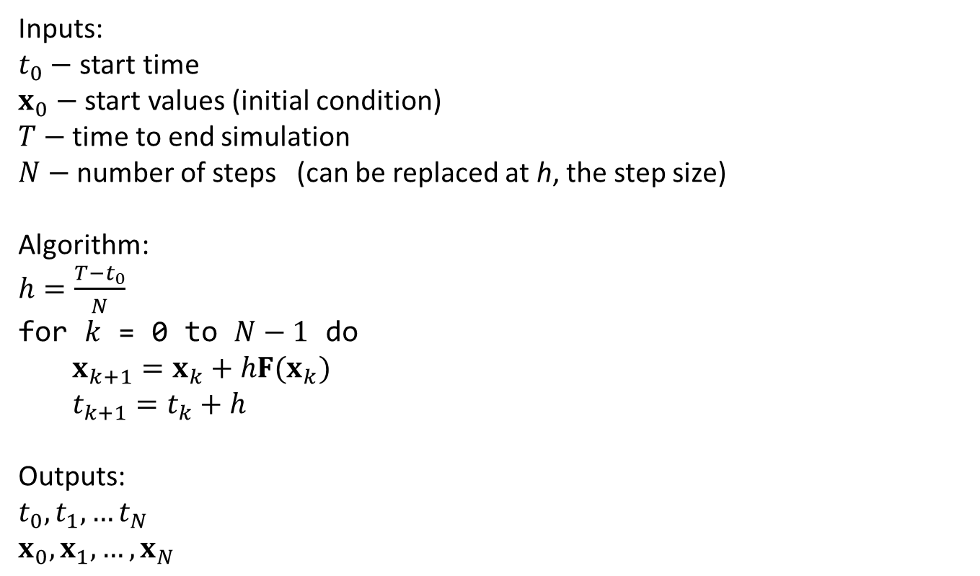
Euler’s Method: Pseudo Code
Inputs:
$t_{0}−$ start time
$x_{0}−$ start values (initial condition)
$T−$ time to end simulation
$N−$ number of steps (can be replaced at h, the step size)
Algorithm:
$h=\frac{T−t_{0}}{N}$
for $k$ = 0 to $N−1$ do
$x_{k+1}=x_{k}+hF(x_{k})$ $t_{k+1}=t_{k}+h$
Outputs:
$t_{0},t_{1},…t_{N}$
$x_{0},x_{1}, …,x_{N}$

Slide 5
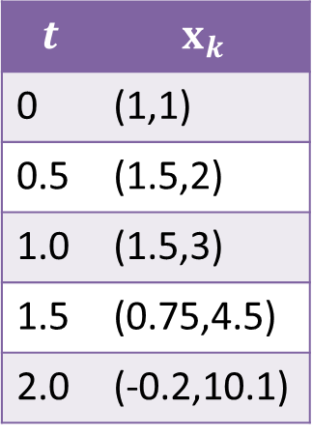
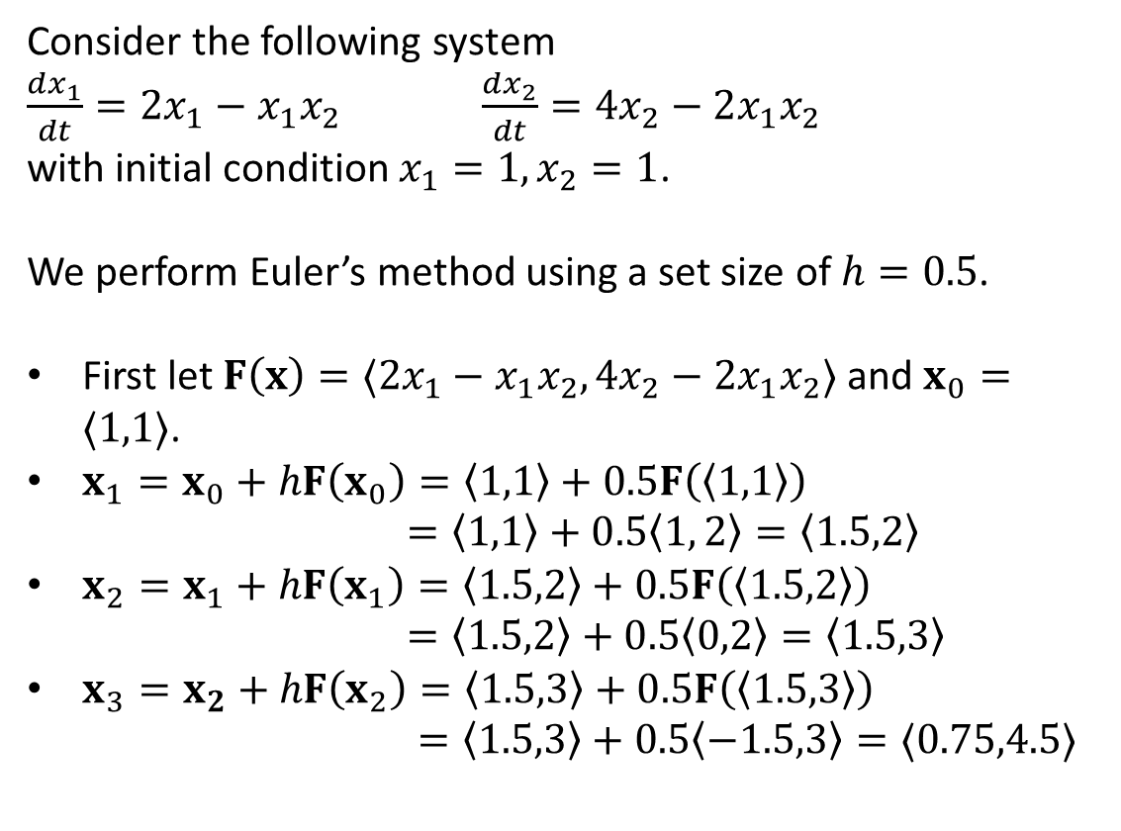
Euler’s Method: Example
Consider the following system
$\frac{dx_{1}}{dt}=2x_{1}−x_{1}x_{2}$ $\frac{dx_{2}}{dt}=4x_{2}−2x_{1}x_{2}$
with initial condition $x_{1}=1, x_{2}=1$.
We perform Euler’s method using a set size of $h=0.5$.
First let $F\left(x\right)=〈2x_{1}−x_{1}x_{2},4x_{2}−2x_{1}x_{2}〉$ and $x_{0}=〈1,1〉$.
$x_{1}=x_{0}+hF\left(x_{0}\right)=〈1,1〉+0.5F\left(〈1,1〉\right)$ $=〈1,1〉+0.5〈1, 2〉=〈1.5,2〉$
$x_{2}=x_{1}+hF\left(x_{1}\right)=〈1.5,2〉+0.5F\left(〈1.5,2〉\right)$ $=〈1.5,2〉+0.5〈0,2〉=〈1.5,3〉$
$x_{3}=x_{2}+hF\left(x_{2}\right)=〈1.5,3〉+0.5F\left(〈1.5,3〉\right)$ $=〈1.5,3〉+0.5〈−1.5,3〉=〈0.75,4.5〉$
Python: euler.py
$$t$$ | $$x_{k}$$
0 | (1,1)
0.5 | (1.5,2)
1.0 | (1.5,3)
1.5 | (0.75,4.5)
2.0 | (-0.2,10.1)

Slide 6
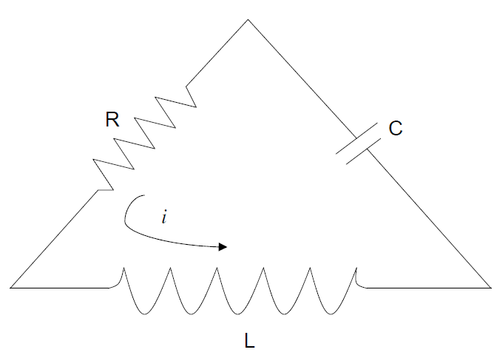
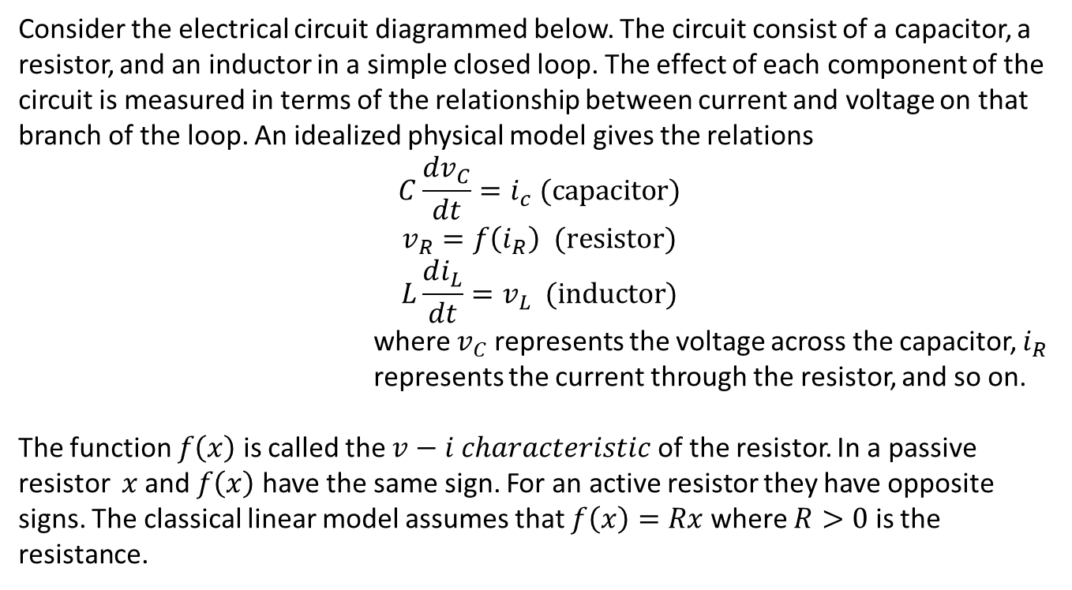
Circuits
Consider the electrical circuit diagrammed below. The circuit consist of a capacitor, a resistor, and an inductor in a simple closed loop. The effect of each component of the circuit is measured in terms of the relationship between current and voltage on that branch of the loop. An idealized physical model gives the relations
$$C\frac{dv_{C}}{dt}=i_{c} (capacitor)$$
$$v_{R}=f\left(i_{R}\right) (resistor)$$
$$L\frac{di_{L}}{dt}=v_{L} (inductor)$$
where $v_{C}$ represents the voltage across the capacitor, $i_{R}$ represents the current through the resistor, and so on.
The function $f\left(x\right)$ is called the $v−i characteristic$ of the resistor. In a passive resistor $x$ and $f\left(x\right)$ have the same sign. For an active resistor they have opposite signs. The classical linear model assumes that $f\left(x\right)=Rx$ where $R>0$ is the resistance.

Slide 7
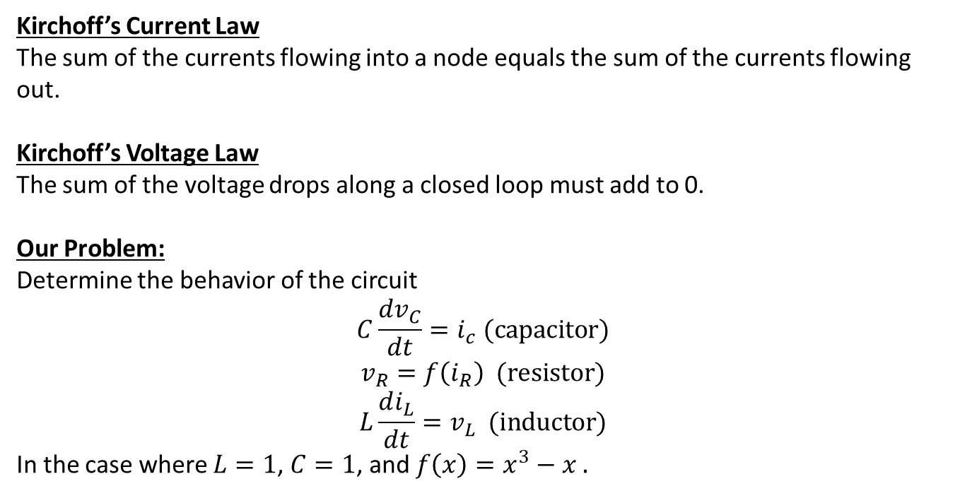
Circuits: Kirchoff’s Current Law
Kirchoff’s Current Law
The sum of the currents flowing into a node equals the sum of the currents flowing out.
Kirchoff’s Voltage Law
The sum of the voltage drops along a closed loop must add to 0.
Our Problem:
Determine the behavior of the circuit
$$C\frac{dv_{C}}{dt}=i_{c} (capacitor)$$
$$v_{R}=f\left(i_{R}\right) (resistor)$$
$$L\frac{di_{L}}{dt}=v_{L} (inductor)$$
In the case where $L=1$, $C=1$, and $f\left(x\right)=x^{3}−x .$

Slide 8
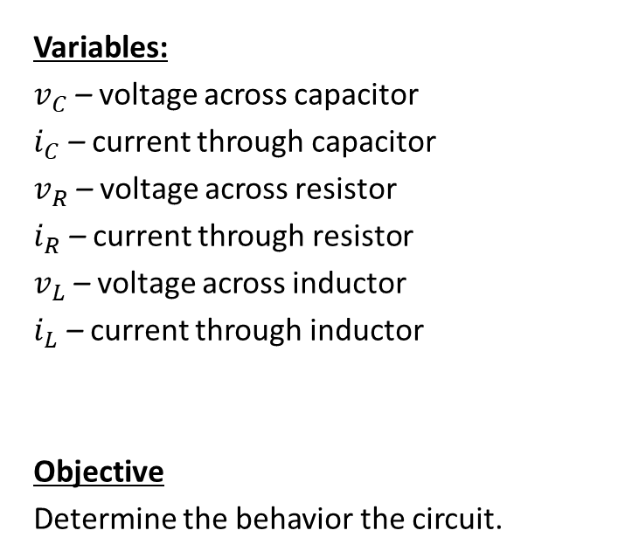
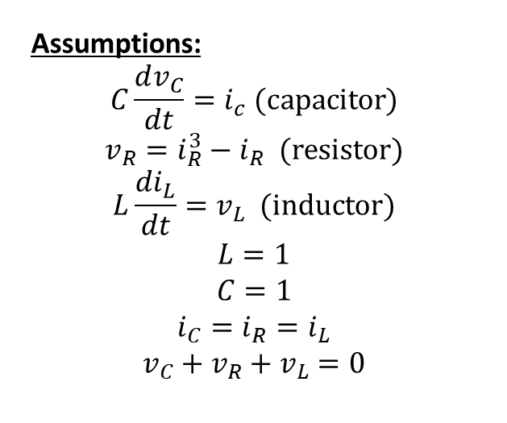
Step 1: Frame the question
Variables:
$v_{C}$ – voltage across capacitor
$i_{C}$ – current through capacitor
$v_{R}$ – voltage across resistor
$i_{R}$ – current through resistor
$v_{L}$ – voltage across inductor
$i_{L}$ – current through inductor
Objective
Determine the behavior the circuit.
Assumptions:
$$C\frac{dv_{C}}{dt}=i_{c} (capacitor)$$
$$v_{R}=i_{R}^{3}−i_{R} (resistor)$$
$$L\frac{di_{L}}{dt}=v_{L} (inductor)$$
$$L=1$$
$$C=1$$
$$i_{C}=i_{R}=i_{L}$$
$$v_{C}+v_{R}+v_{L}=0$$

Slide 9
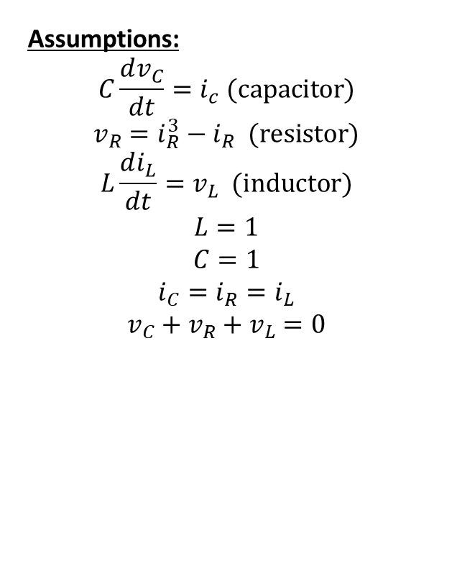
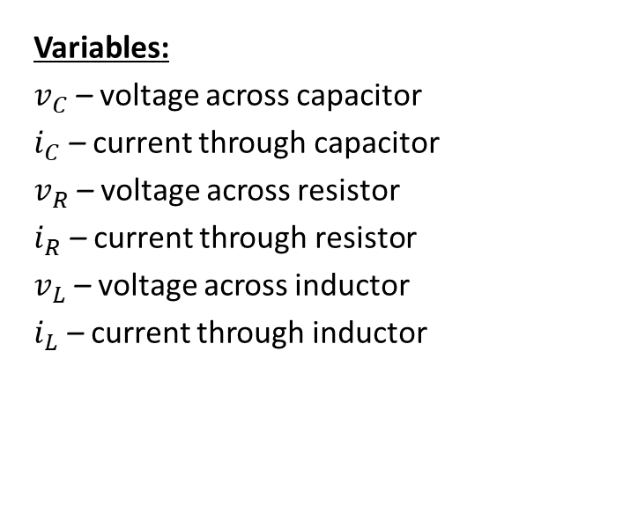
Step 2: Select the modeling approach
Variables:
$v_{C}$ – voltage across capacitor
$i_{C}$ – current through capacitor
$v_{R}$ – voltage across resistor
$i_{R}$ – current through resistor
$v_{L}$ – voltage across inductor
$i_{L}$ – current through inductor
Assumptions:
$$C\frac{dv_{C}}{dt}=i_{c} (capacitor)$$
$$v_{R}=i_{R}^{3}−i_{R} (resistor)$$
$$L\frac{di_{L}}{dt}=v_{L} (inductor)$$
$$L=1$$
$$C=1$$
$$i_{C}=i_{R}=i_{L}$$
$$v_{C}+v_{R}+v_{L}=0$$
Objective
Determine the behavior the circuit
Approach
We model this as a continuous time dynamical system and analyze the system by sketching a complete phase portrait.

Slide 10
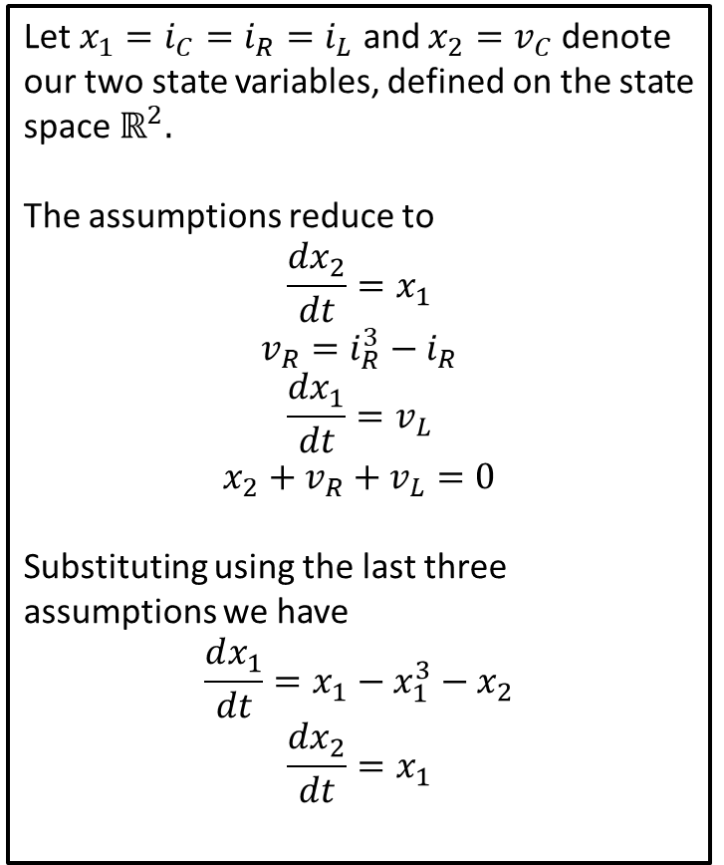
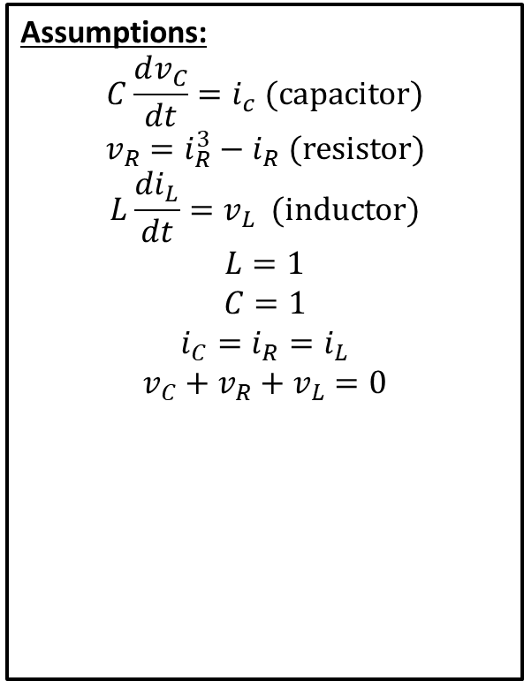
Step 3: Formulate the model
Assumptions:
$$C\frac{dv_{C}}{dt}=i_{c} (capacitor)$$
$$v_{R}=i_{R}^{3}−i_{R} (resistor)$$
$$L\frac{di_{L}}{dt}=v_{L} (inductor)$$
$$L=1$$
$$C=1$$
$$i_{C}=i_{R}=i_{L}$$
$$v_{C}+v_{R}+v_{L}=0$$
Let $x_{1}=i_{C}=i_{R}=i_{L}$ and $x_{2}=v_{C}$ denote our two state variables, defined on the state space $ℝ^{2}.$
The assumptions reduce to
$$\frac{dx_{2}}{dt}=x_{1}$$
$$v_{R}=i_{R}^{3}−i_{R}$$
$$\frac{dx_{1}}{dt}=v_{L}$$
$$x_{2}+v_{R}+v_{L}=0$$
Substituting using the last three assumptions we have
$$\frac{dx_{1}}{dt}=x_{1}−x_{1}^{3}−x_{2}$$
$$\frac{dx_{2}}{dt}=x_{1}$$

Slide 11

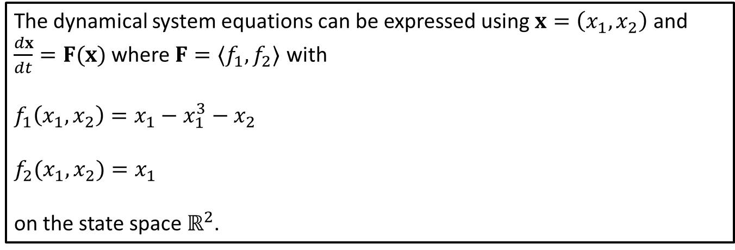
Step 3: Formulation of Model
We were left with the dynamical system
$$\frac{dx_{1}}{dt}=x_{1}−x_{1}^{3}−x_{2}$$
$$\frac{dx_{2}}{dt}=x_{1}$$
The dynamical system equations can be expressed using $x=\left(x_{1},x_{2}\right)$ and $\frac{dx}{dt}=F(x)$ where $F=〈f_{1},f_{2}〉$ with
$$f_{1}\left(x_{1},x_{2}\right)=x_{1}−x_{1}^{3}−x_{2}$$
$$f_{2}(x_{1},x_{2})=x_{1}$$
on the state space $ℝ^{2}$.

Slide 12
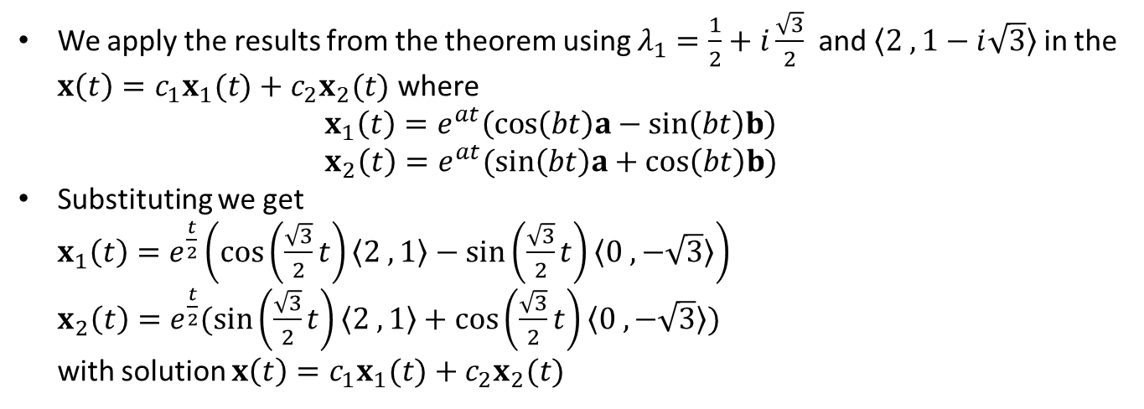
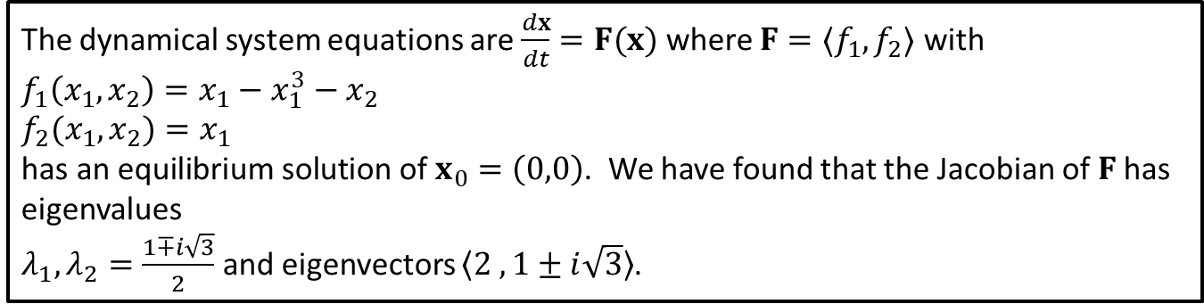
Recall Example 5.4
The dynamical system equations are $\frac{dx}{dt}=F(x)$ where $F=〈f_{1},f_{2}〉$ with
$$f_{1}\left(x_{1},x_{2}\right)=x_{1}−x_{1}^{3}−x_{2}$$
$$f_{2}(x_{1},x_{2})=x_{1}$$
$\text{has} \text{an} \text{equilibrium} \text{solution} \text{of} x_{0}=\left(0,0\right)$. We have found that the Jacobian of $F$has eigenvalues
$λ_{1},λ_{2}=\frac{1∓i\sqrt{3}}{2}$ and eigenvectors $〈2 ,1±i\sqrt{3}〉$.
We apply the results from the theorem using $λ_{1}=\frac{1}{2}+i\frac{\sqrt{3}}{2}$ and $〈2 ,1−i\sqrt{3}〉$ in the $x\left(t\right)=c_{1}x_{1}(t)+c_{2}x_{2}(t)$ where $x_{1}\left(t\right)=e^{at}\left(cos\left(bt\right)a−sin\left(bt\right)b\right)$ $x_{2}\left(t\right)=e^{at}(sin\left(bt\right)a+cos\left(bt\right)b)$
Substituting we get $x_{1}\left(t\right)=e^{\frac{t}{2}}\left(cos\left(\frac{\sqrt{3}}{2}t\right)〈2 ,1〉−sin\left(\frac{\sqrt{3}}{2}t\right)〈0 ,−\sqrt{3}〉\right)$ $x_{2}\left(t\right)=e^{\frac{t}{2}}(sin\left(\frac{\sqrt{3}}{2}t\right)〈2 ,1〉+cos\left(\frac{\sqrt{3}}{2}t\right)〈0 ,−\sqrt{3}〉)$ with solution $x\left(t\right)=c_{1}x_{1}(t)+c_{2}x_{2}(t)$
Notes:
At t changes e^t/2 grows without bound, but sin and cos bounce b/t -1 and 1

Slide 13
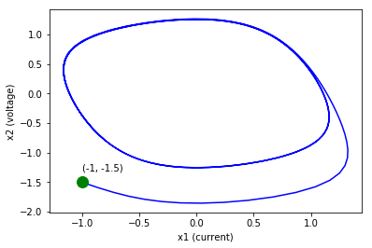
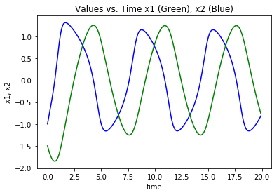
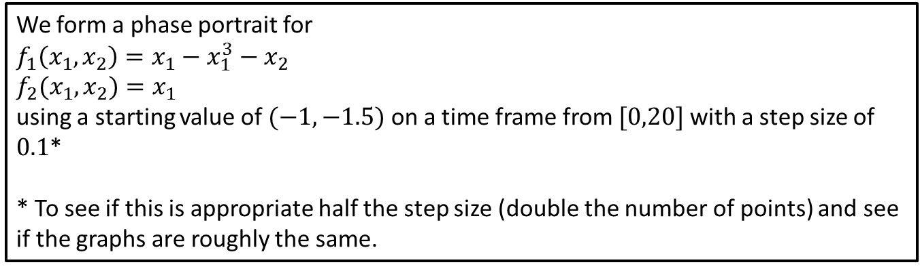
Step 4: Solve the Problem
We form a phase portrait for
$$f_{1}\left(x_{1},x_{2}\right)=x_{1}−x_{1}^{3}−x_{2}$$
$$f_{2}(x_{1},x_{2})=x_{1}$$
using a starting value of $(−1,−1.5)$ on a time frame from $[0,20]$ with a step size of $0.1$*
* To see if this is appropriate half the step size (double the number of points) and see if the graphs are roughly the same.

Slide 14
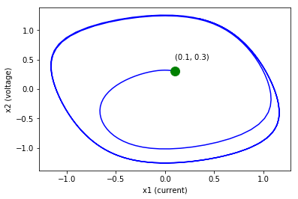
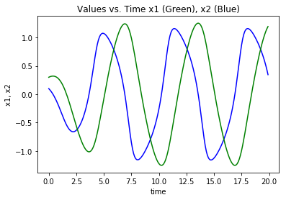
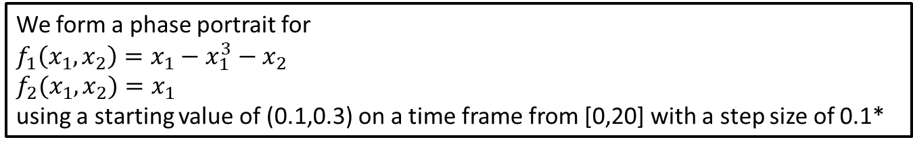
Step 4: Solve the Problem
We form a phase portrait for
$$f_{1}\left(x_{1},x_{2}\right)=x_{1}−x_{1}^{3}−x_{2}$$
$$f_{2}(x_{1},x_{2})=x_{1}$$
using a starting value of (0.1,0.3) on a time frame from [0,20] with a step size of 0.1*

Slide 15
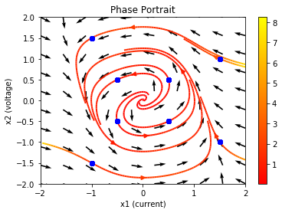
Step 4: Solve the Problem
In both scenarios the solution begins to take a periodic structure.
If the initial condition begins “inside” the solution spiral’s out towards the loop.
If the initial condition begins “outside” the solution spiral’s in towards the loop.
The closed loop is called a limit cycle.
Phase Portrait with several initial conditions “inside” and several initial conditions “outside” the limit cycle

Slide 16
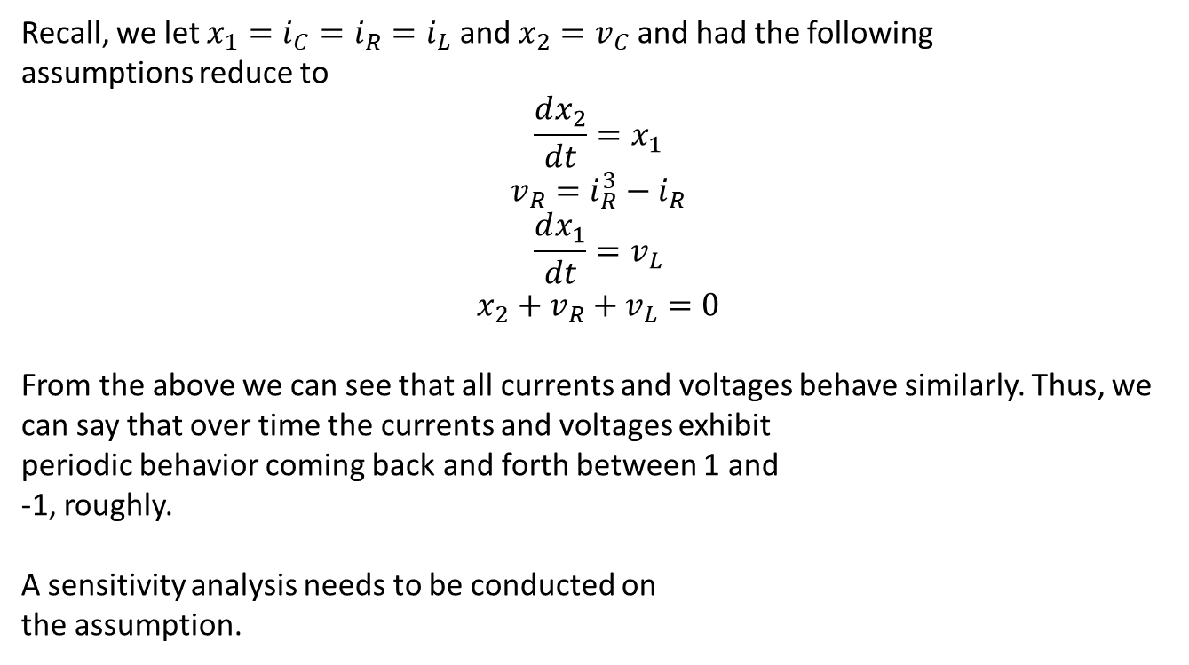
Step 5: Answer the question
Recall, we let $x_{1}=i_{C}=i_{R}=i_{L}$ and $x_{2}=v_{C}$ and had the following
assumptions reduce to
$$\frac{dx_{2}}{dt}=x_{1}$$
$$v_{R}=i_{R}^{3}−i_{R}$$
$$\frac{dx_{1}}{dt}=v_{L}$$
$$x_{2}+v_{R}+v_{L}=0$$
From the above we can see that all currents and voltages behave similarly. Thus, we can say that over time the currents and voltages exhibit periodic behavior coming back and forth between 1 and -1, roughly.
A sensitivity analysis needs to be conducted on
the assumption.

Slide 17
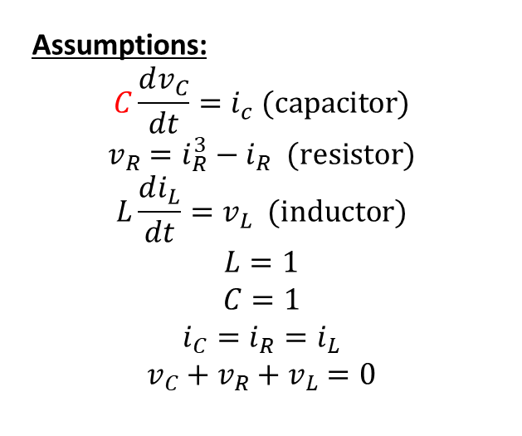
Sensitivity Analysis on C
Variables:
$v_{C}$ – voltage across capacitor
$i_{C}$ – current through capacitor
$v_{R}$ – voltage across resistor
$i_{R}$ – current through resistor
$v_{L}$ – voltage across inductor
$i_{L}$ – current through inductor
Objective
Determine the behavior of all six variables over time.
Assumptions:
$$C\frac{dv_{C}}{dt}=i_{c} (capacitor)$$
$$v_{R}=i_{R}^{3}−i_{R} (resistor)$$
$$L\frac{di_{L}}{dt}=v_{L} (inductor)$$
$$L=1$$
$$C=1$$
$$i_{C}=i_{R}=i_{L}$$
$$v_{C}+v_{R}+v_{L}=0$$
Parameter
$C$ – relates change in voltage of capacitor to the capacitor’s current.

Slide 18
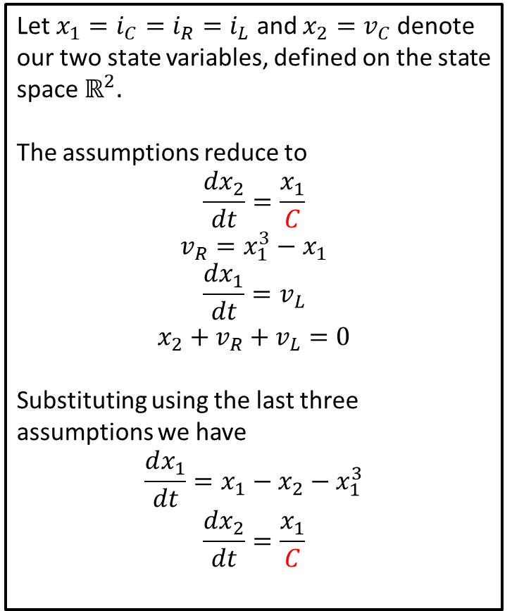
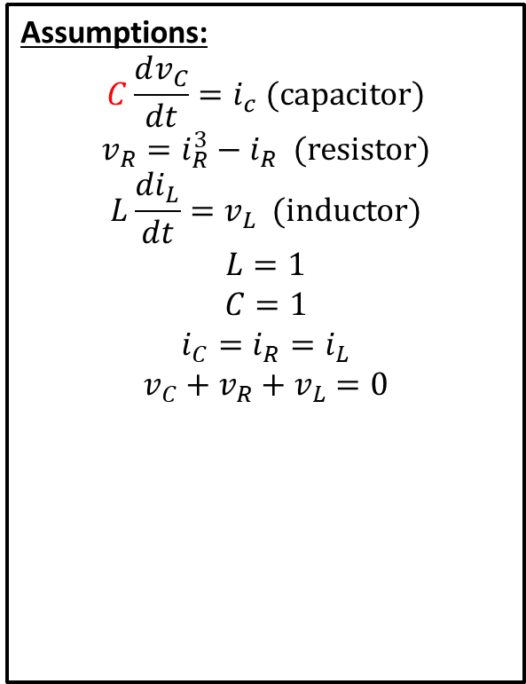
Changes to Model
Assumptions:
$$C\frac{dv_{C}}{dt}=i_{c} (capacitor)$$
$$v_{R}=i_{R}^{3}−i_{R} (resistor)$$
$$L\frac{di_{L}}{dt}=v_{L} (inductor)$$
$$L=1$$
$$C=1$$
$$i_{C}=i_{R}=i_{L}$$
$$v_{C}+v_{R}+v_{L}=0$$
Let $x_{1}=i_{C}=i_{R}=i_{L}$ and $x_{2}=v_{C}$ denote our two state variables, defined on the state space $ℝ^{2}.$
The assumptions reduce to
$$\frac{dx_{2}}{dt}=\frac{x_{1}}{C}$$
$$v_{R}=x_{1}^{3}−x_{1}$$
$$\frac{dx_{1}}{dt}=v_{L}$$
$$x_{2}+v_{R}+v_{L}=0$$
Substituting using the last three assumptions we have
$$\frac{dx_{1}}{dt}=x_{1}−x_{2}−x_{1}^{3}$$
$$\frac{dx_{2}}{dt}=\frac{x_{1}}{C}$$

Slide 19

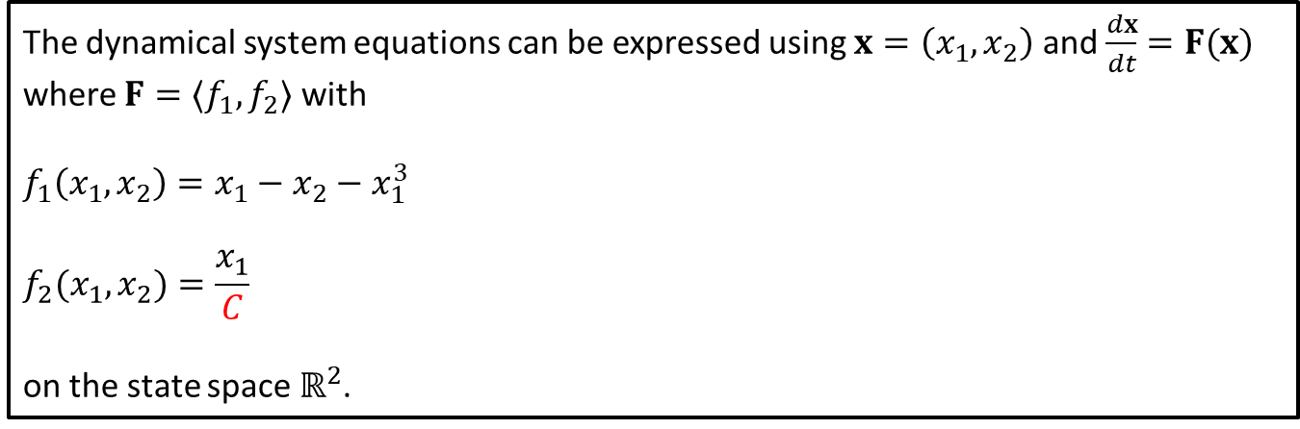
Changes to Formulation of Model
We are left with the dynamical system
$$\frac{dx_{1}}{dt}=x_{1}−x_{2}−x_{1}^{3}$$
$$\frac{dx_{2}}{dt}=\frac{x_{1}}{C}$$
The dynamical system equations can be expressed using $x=\left(x_{1},x_{2}\right)$ and $\frac{dx}{dt}=F(x)$ where $F=〈f_{1},f_{2}〉$ with
$$f_{1}\left(x_{1},x_{2}\right)=x_{1}−x_{2}−x_{1}^{3}$$
$$f_{2}(x_{1},x_{2})=\frac{x_{1}}{C}$$
on the state space $ℝ^{2}$.

Slide 20
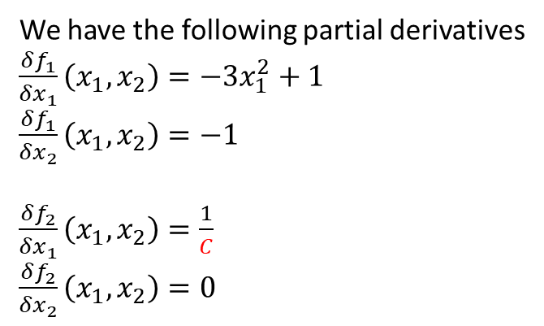
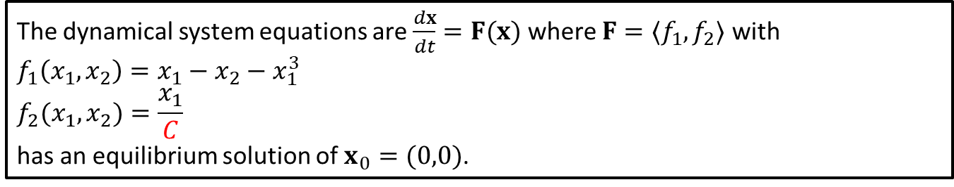
Solutions
The dynamical system equations are $\frac{dx}{dt}=F(x)$ where $F=〈f_{1},f_{2}〉$ with
$$f_{1}\left(x_{1},x_{2}\right)=x_{1}−x_{2}−x_{1}^{3}$$
$$f_{2}(x_{1},x_{2})=\frac{x_{1}}{C}$$
has an equilibrium solution of $x_{0}=(0,0)$.
We now find the Jacobian
$$J(x_{0})=\left[\begin{matrix}\frac{δf_{1}}{δx_{1}}(x_{0}) & ⋯ & \frac{δf_{1}}{δx_{n}}(x_{0}) \\ ⋮ & ⋱ & ⋮ \\ \frac{δf_{n}}{δx_{1}}(x_{0}) & ⋯ & \frac{δf_{n}}{δx_{n}}(x_{0})\end{matrix}\right]$$
and substitute the equilibrium solution of $x_{0}=(0,0$).
We have the following partial derivatives
$\frac{δf_{1}}{δx_{1}}\left(x_{1}, x_{2}\right)=−3x_{1}^{2}+1$
$\frac{δf_{1}}{δx_{2}}\left(x_{1}, x_{2}\right)=−1$
$\frac{δf_{2}}{δx_{1}}\left(x_{1}, x_{2}\right)=\frac{1}{C}$
$\frac{δf_{2}}{δx_{2}}\left(x_{1}, x_{2}\right)=0$
Notes:
See python file section1-1pig.py

Slide 21
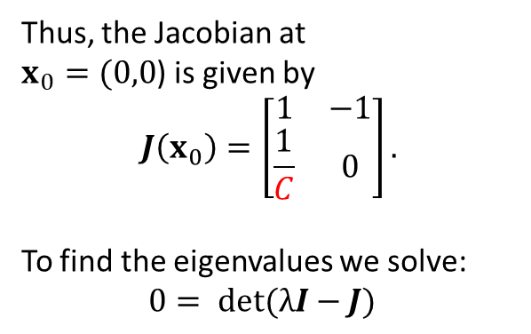
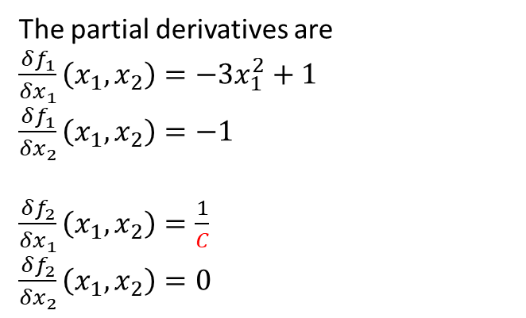
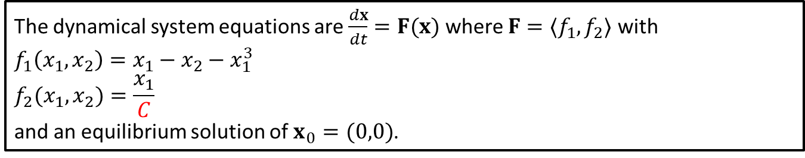
Jacobian
The dynamical system equations are $\frac{dx}{dt}=F(x)$ where $F=〈f_{1},f_{2}〉$ with
$$f_{1}\left(x_{1},x_{2}\right)=x_{1}−x_{2}−x_{1}^{3}$$
$$f_{2}(x_{1},x_{2})=\frac{x_{1}}{C}$$
and an equilibrium solution of $x_{0}=(0,0)$.
The partial derivatives are
$\frac{δf_{1}}{δx_{1}}\left(x_{1}, x_{2}\right)=−3x_{1}^{2}+1$
$\frac{δf_{1}}{δx_{2}}\left(x_{1}, x_{2}\right)=−1$
$\frac{δf_{2}}{δx_{1}}\left(x_{1}, x_{2}\right)=\frac{1}{C}$
$\frac{δf_{2}}{δx_{2}}\left(x_{1}, x_{2}\right)=0$
Thus, the Jacobian at $x_{0}=(0,0$) is given by
$$J\left(x_{0}\right)=\left[\begin{matrix}1 & −1 \\ \frac{1}{C} & 0\end{matrix}\right].$$
To find the eigenvalues we solve:
$$0= det(λI−J)$$
Notes:
See python file section1-1pig.py

Slide 22
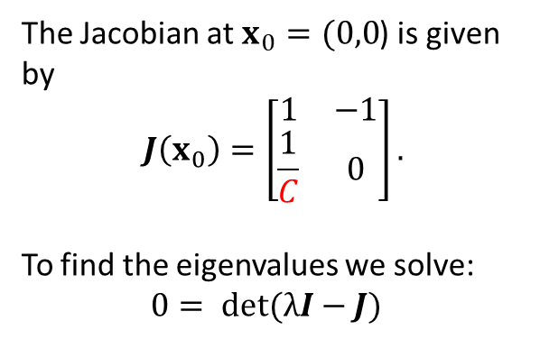
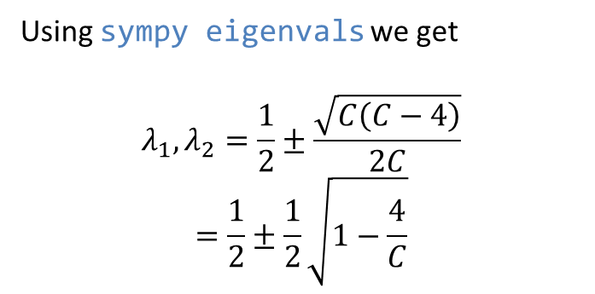
Eigenvalues and Eigenvectors
The dynamical system equations are $\frac{dx}{dt}=F(x)$ where $F=〈f_{1},f_{2}〉$ with
$$f_{1}\left(x_{1},x_{2}\right)=x_{1}−x_{2}−x_{1}^{3}$$
$$f_{2}(x_{1},x_{2})=\frac{x_{1}}{C}$$
and an equilibrium solution of $x_{0}=(0,0)$.
The Jacobian at $x_{0}=(0,0$) is given by
$$J\left(x_{0}\right)=\left[\begin{matrix}1 & −1 \\ \frac{1}{C} & 0\end{matrix}\right].$$
To find the eigenvalues we solve:
$$0= det(λI−J)$$
Using sympy eigenvals we get
$$λ_{1},λ_{2}=\frac{1}{2}±\frac{\sqrt{C\left(C−4\right)}}{2C}$$
$$=\frac{1}{2}±\frac{1}{2}\sqrt{1−\frac{4}{C}}$$

Slide 23
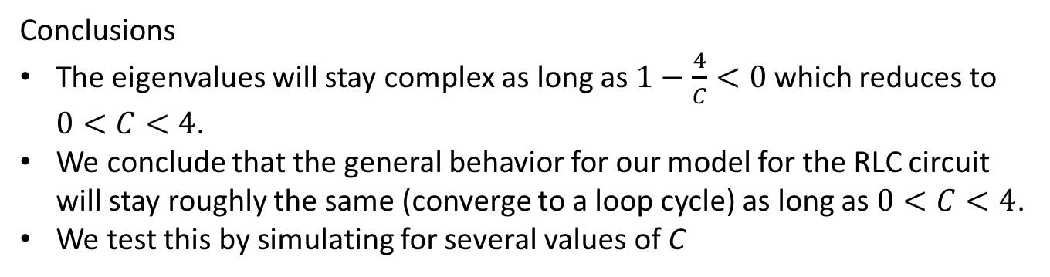
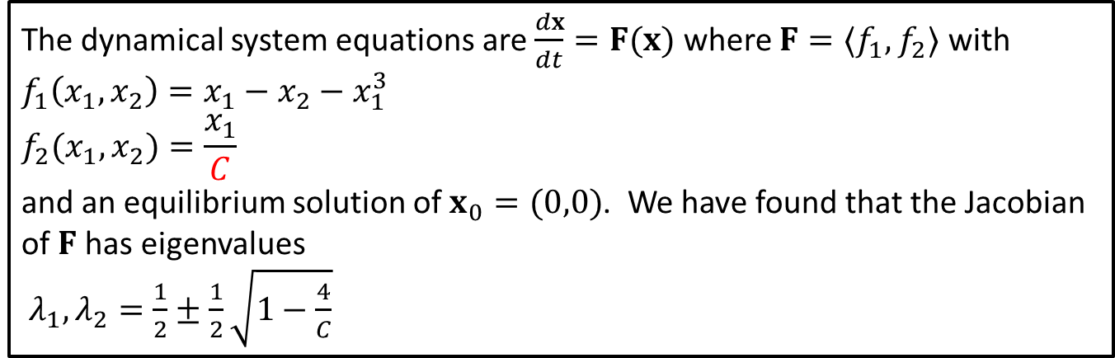
Sensitivity Analysis: Conclusion
The dynamical system equations are $\frac{dx}{dt}=F(x)$ where $F=〈f_{1},f_{2}〉$ with
$$f_{1}\left(x_{1},x_{2}\right)=x_{1}−x_{2}−x_{1}^{3}$$
$$f_{2}(x_{1},x_{2})=\frac{x_{1}}{C}$$
and an equilibrium solution of $x_{0}=(0,0)$. We have found that the Jacobian of $F$has eigenvalues
$λ_{1},λ_{2}=\frac{1}{2}±\frac{1}{2}\sqrt{1−\frac{4}{C}}$
Conclusions
The eigenvalues will stay complex as long as $1−\frac{4}{C}<0$ which reduces to $0<C<4$.
We conclude that the general behavior for our model for the RLC circuit will stay roughly the same (converge to a loop cycle) as long as $0<C<4$.
We test this by simulating for several values of C

Slide 24
Sensitivity Analysis: C = 1 (Original)

Slide 25
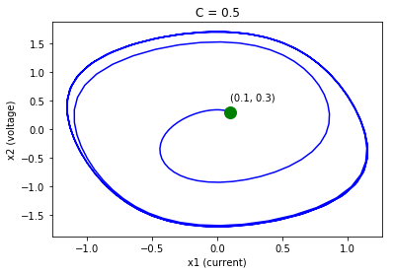
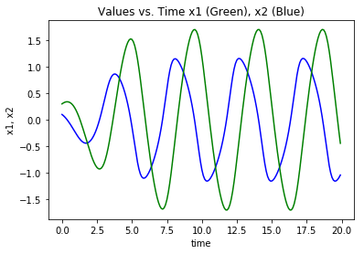
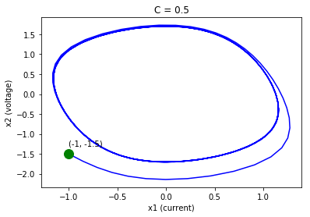
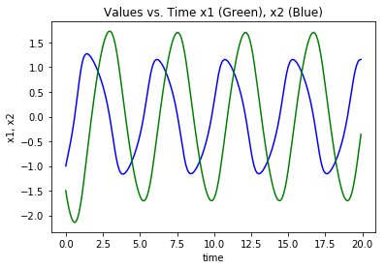
Sensitivity Analysis: C = 0.5

Slide 26
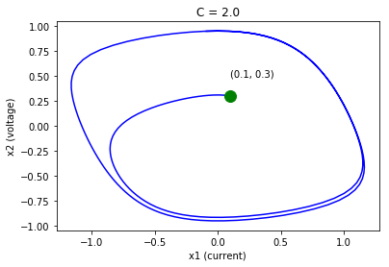
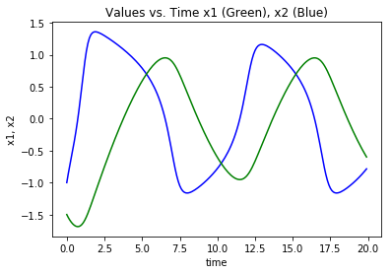
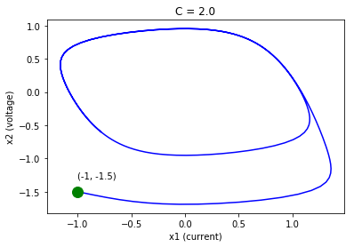
Sensitivity Analysis: C = 2.0

Slide 27
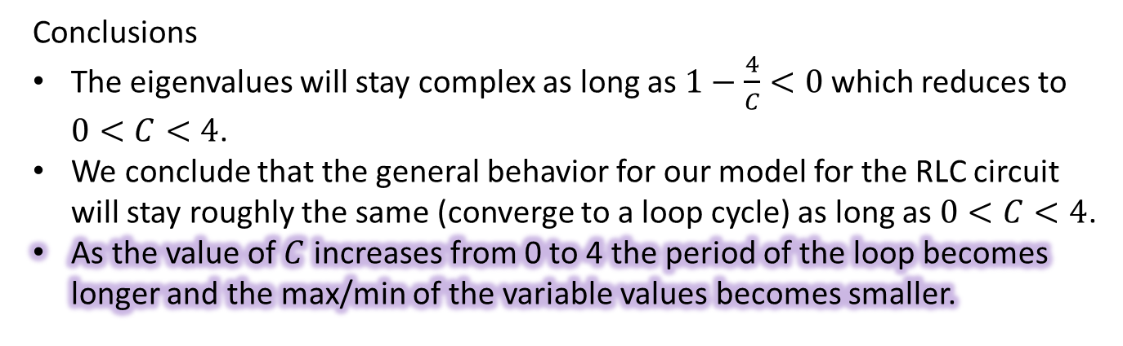
Sensitivity Analysis: Conclusion (Again)
The dynamical system equations are $\frac{dx}{dt}=F(x)$ where $F=〈f_{1},f_{2}〉$ with
$$f_{1}\left(x_{1},x_{2}\right)=x_{1}−x_{2}−x_{1}^{3}$$
$$f_{2}(x_{1},x_{2})=\frac{x_{1}}{C}$$
and an equilibrium solution of $x_{0}=(0,0)$. We have found that the Jacobian of $F$has eigenvalues
$λ_{1},λ_{2}=\frac{1}{2}±\frac{1}{2}\sqrt{1−\frac{4}{C}}$
Conclusions
The eigenvalues will stay complex as long as $1−\frac{4}{C}<0$ which reduces to $0<C<4$.
We conclude that the general behavior for our model for the RLC circuit will stay roughly the same (converge to a loop cycle) as long as $0<C<4$.
As the value of $C$ increases from 0 to 4 the period of the loop becomes longer and the max/min of the variable values becomes smaller.

